Slide 1
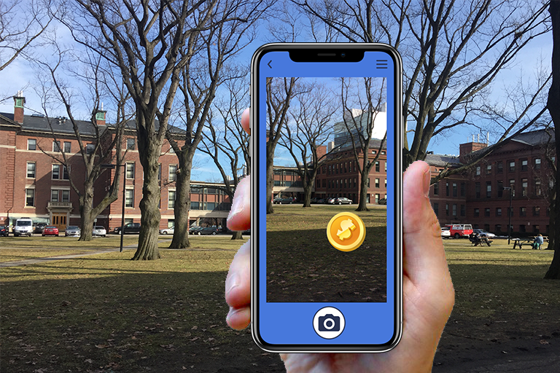

Notes:
Problem
Was it clear what your idea was
How does it work? Benefits

Slide 2

Problem

Slide 3
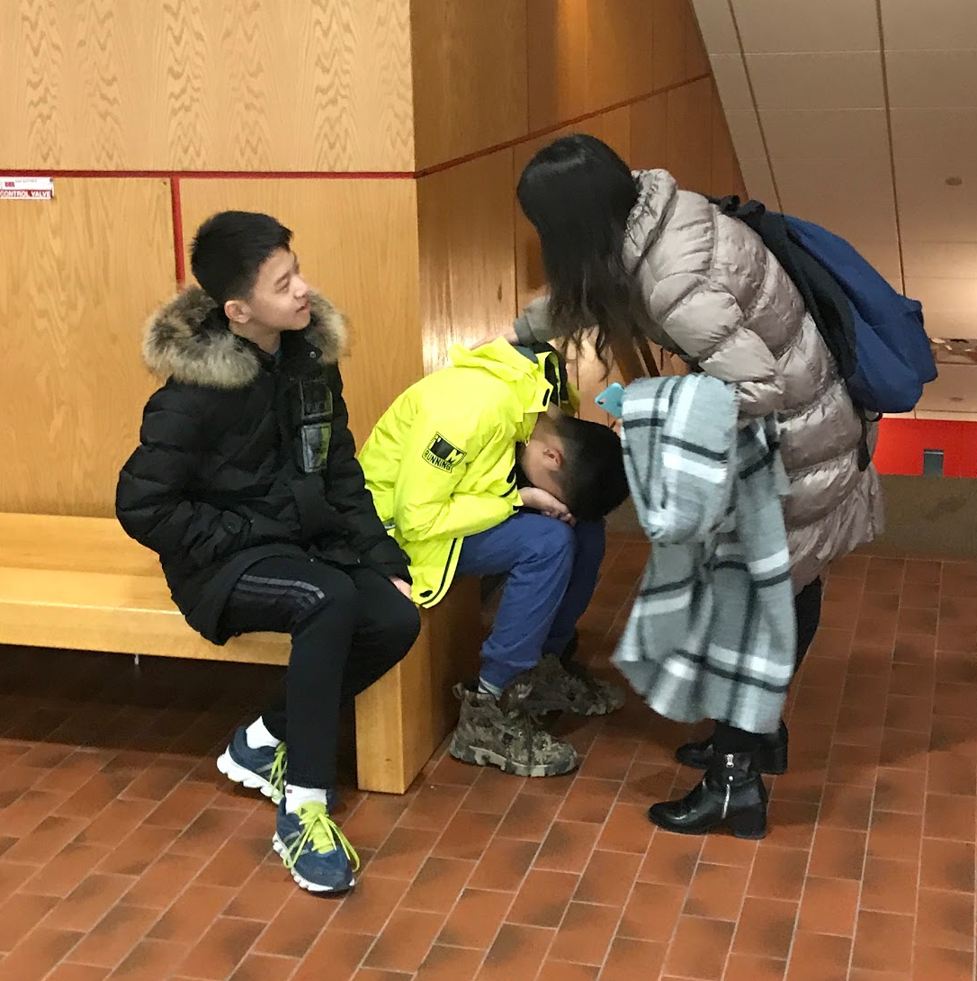
Notes:
Robbie’s interview
Tour itself can be unengaging for younger tourists
Specific target group for improved delivery
Realized a need for a platform for youngster-friendly Harvard Tour
(photo of the bored child)

Slide 4
Solution

Slide 5
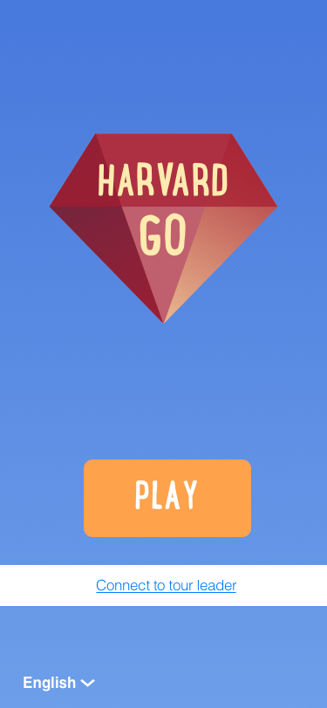
Notes:
Alice first speaks about what the app in general terms
Language button

Slide 6
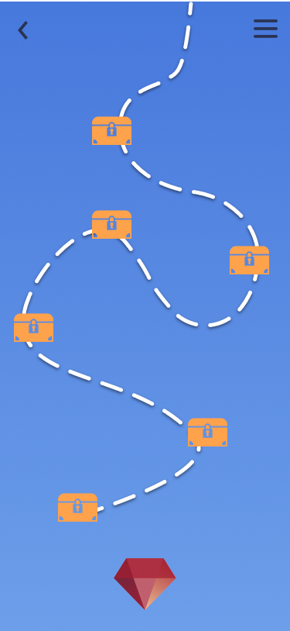
Notes:
Map view - shows how many treasures there are to collect

Slide 7
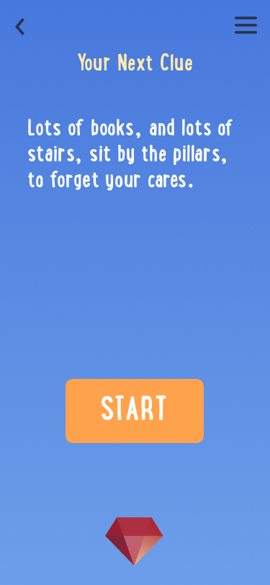
Notes:
Solving riddles - confirmed that this is something middle school students would have fun with

Slide 8
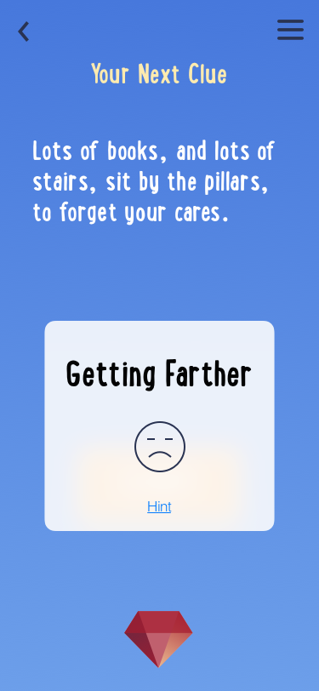
Notes:
Make screen held in hand
Indicator screens pop up to guide students while searching for treasure

Slide 9
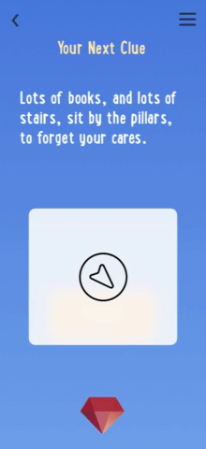
Notes:
Make screen held in hand

Slide 10
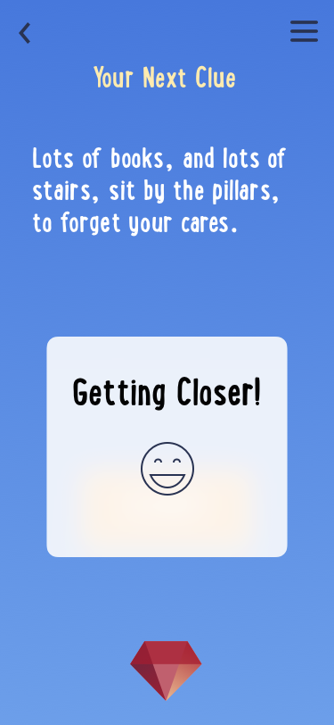
Notes:
Make screen held in hand

Slide 11
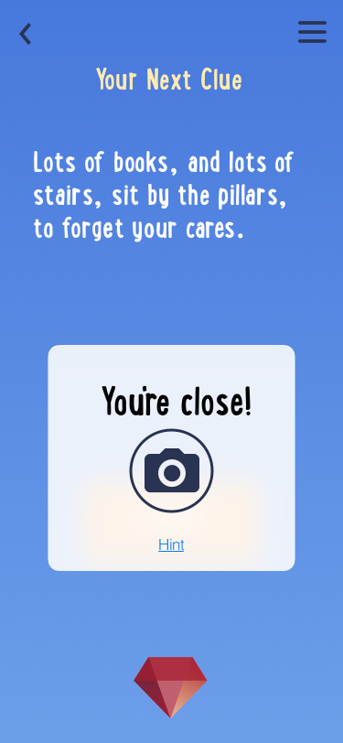
Notes:
Incorporates the picture-taking tendencies of tourists into the app to collect treasure

Slide 12
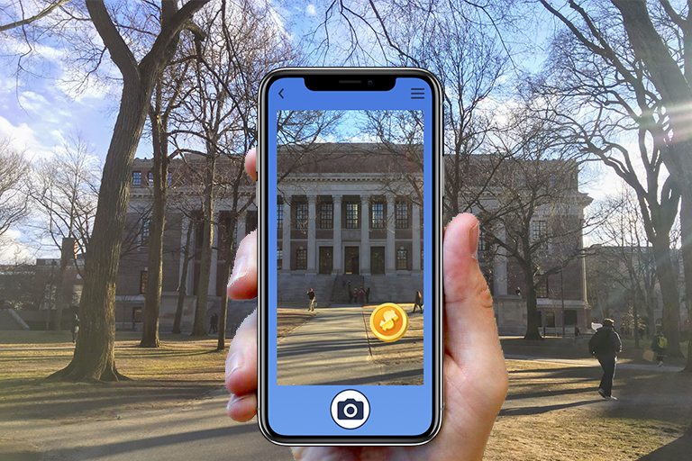
Notes:
CHANGE TO WIDENER SCREEN
Problem
Was it clear what your idea was
How does it work? Benefits

Slide 13
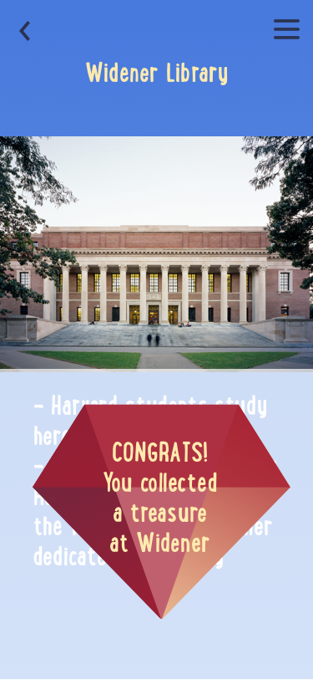
Notes:
Change pic of widener to more cartoon

Slide 14
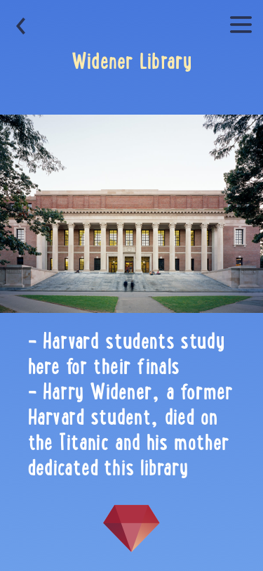
Notes:
Change pic of widener to more cartoon

Slide 15
Parent Features

Slide 16

Notes:
Language button
Choose route instead of play button

Slide 17
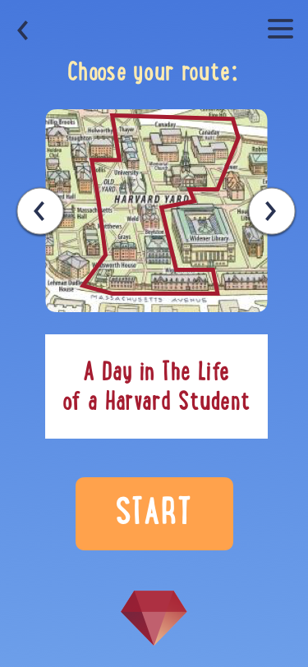
Notes:
animate

Slide 18
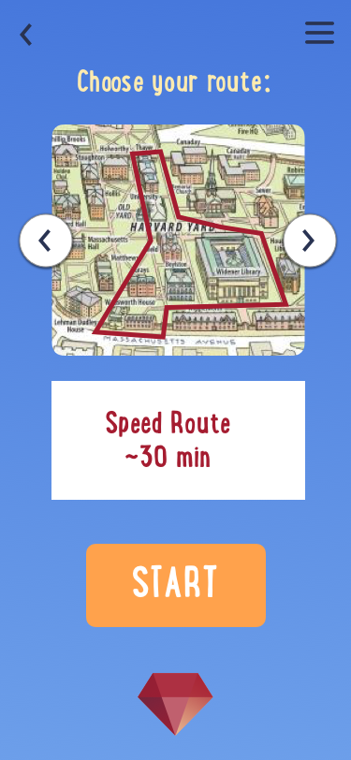
Notes:
animate

Slide 19
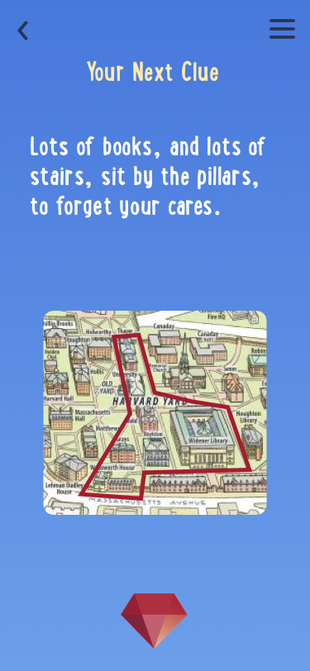

Slide 20
User Feedback

Slide 21
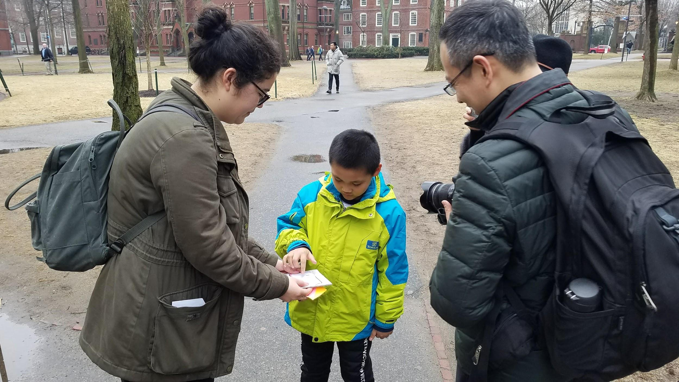
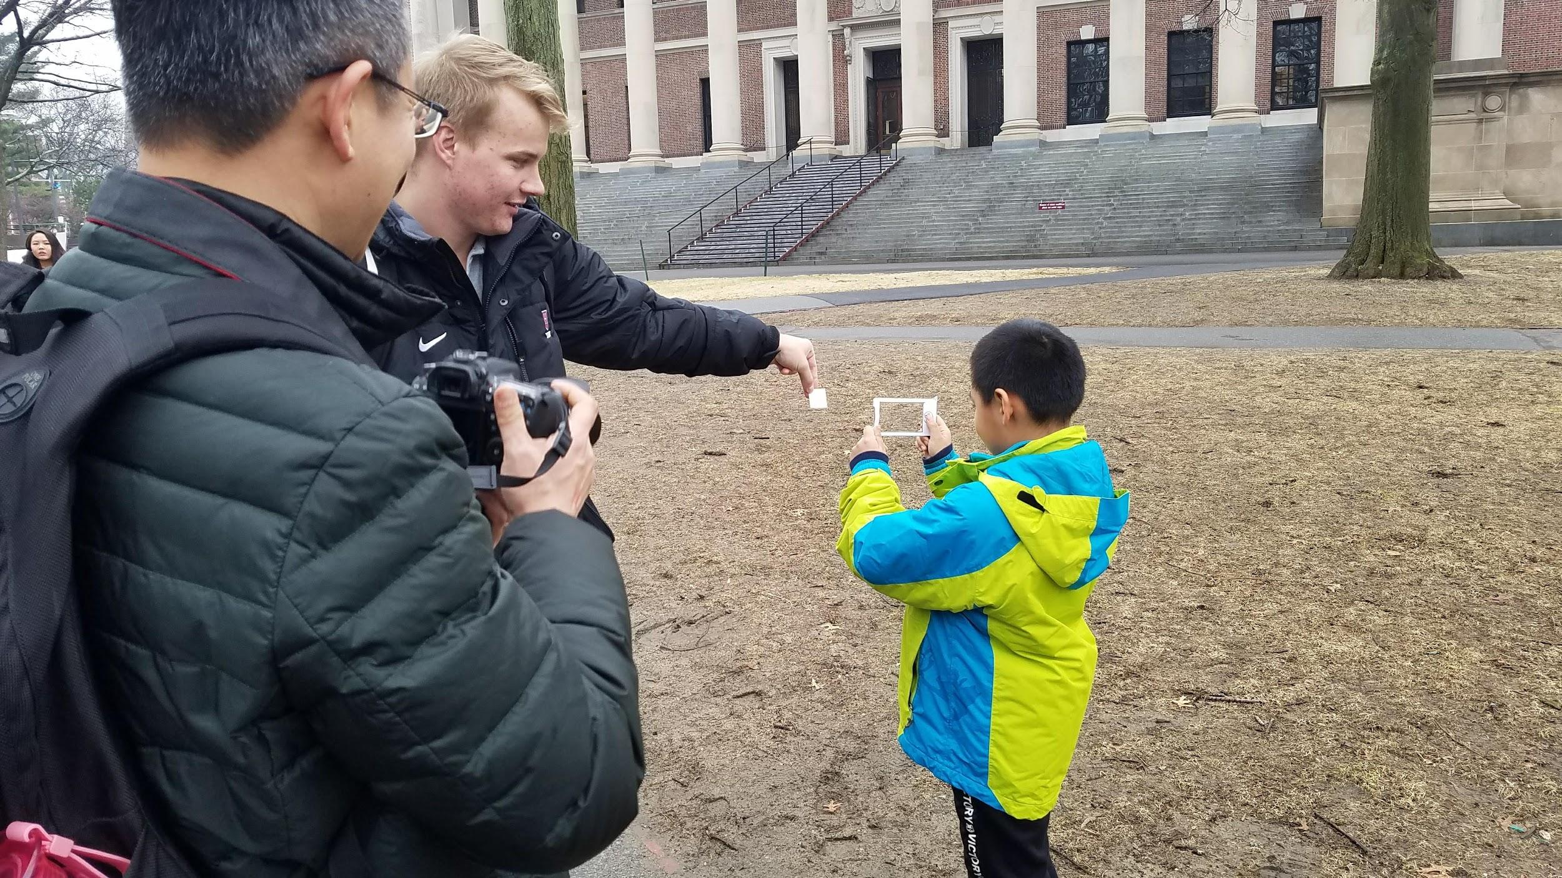
“I think my son will enjoy this - he loved Pokemon Go!“
Tourist parent, excited to have his son talk to Harvard students
Notes:
The son was bored, but he entertained himself by taking photos with his dad’s camera.
While the kid was distracted with us it allowed the dad to use his own camera to take pictures of campus as well as of his son playing the game – i.e. improved both the son and the parents’ experience.
The son was shy but liked the game and was visibly excited when he found the jewel.

Slide 22
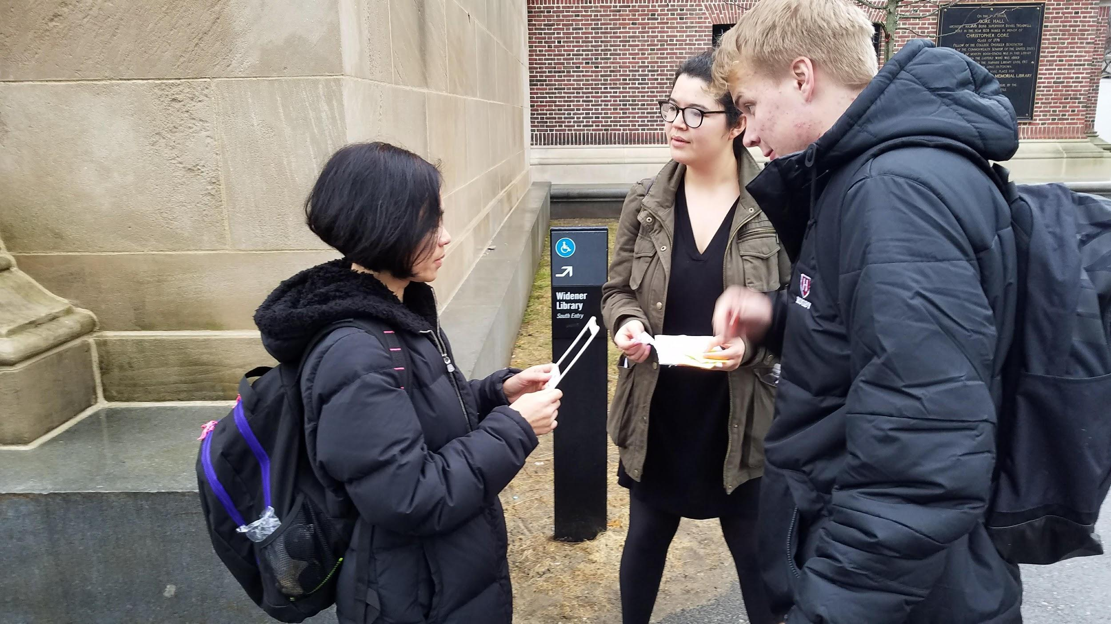
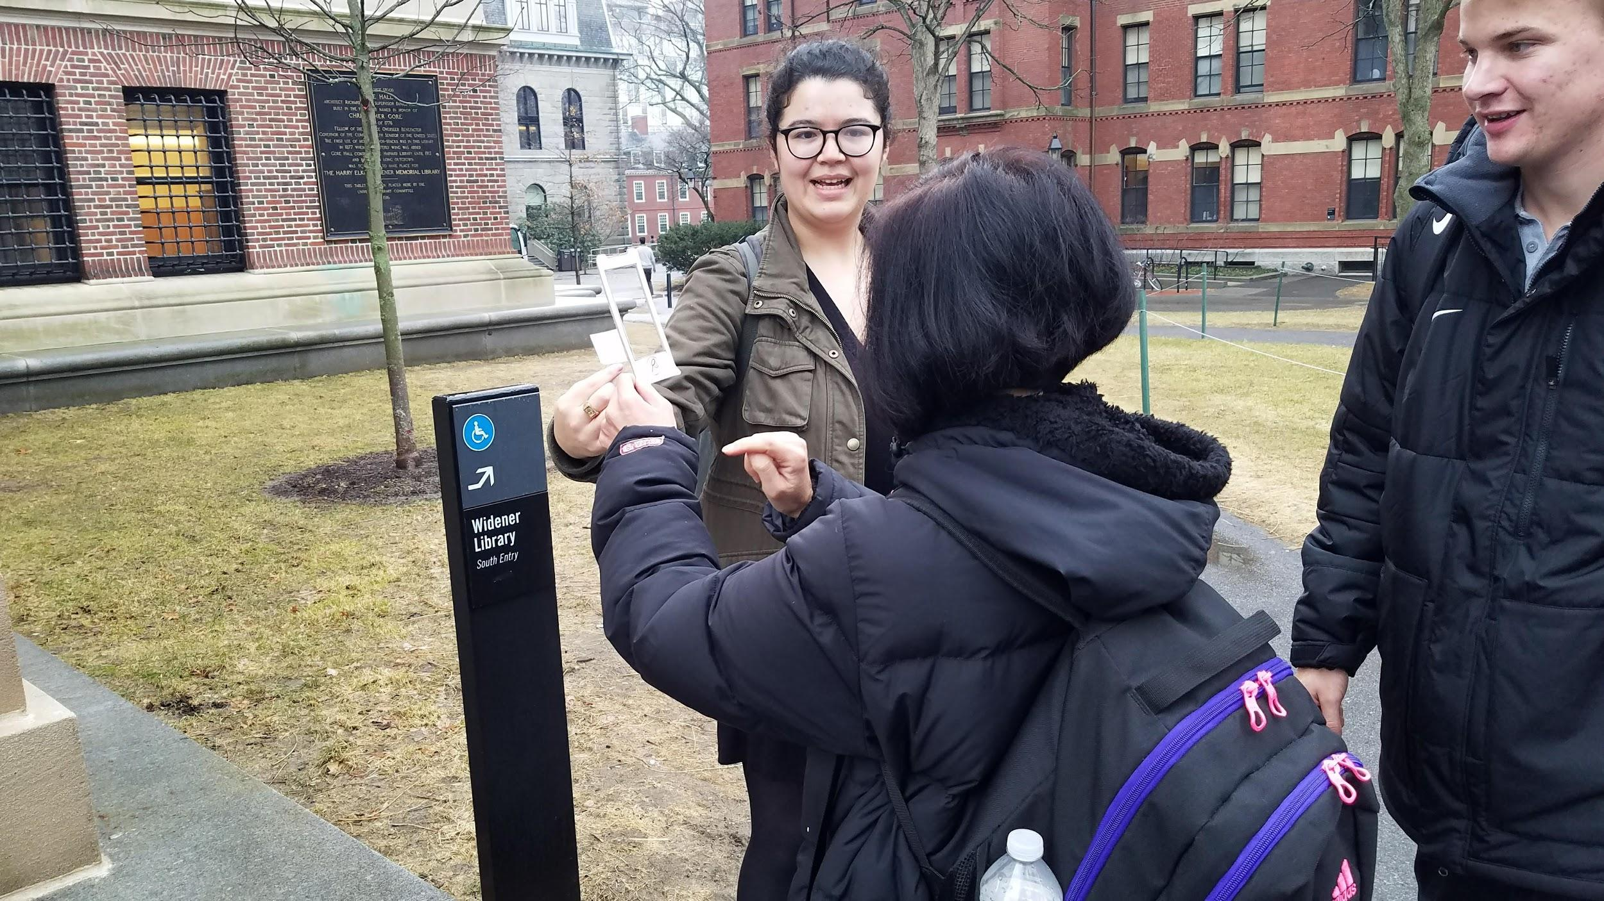
“I wouldn’t mind letting my son stay on his phone. At least he’s engaging with Harvard’s campus now.”
Tourist parent, eager to get a break and take pictures of her own
Notes:
“I’m wondering which building it is” – interest piqued by the riddle
She wanted info about Widener – it should have gone directly to widener info after finding the jewel/arriving
Thought her son would enjoy – always sees him doing AR on his phone.
At first she didn’t have time, but then she insisted that we go to Widener so that we could run through the whole demo.

Slide 23
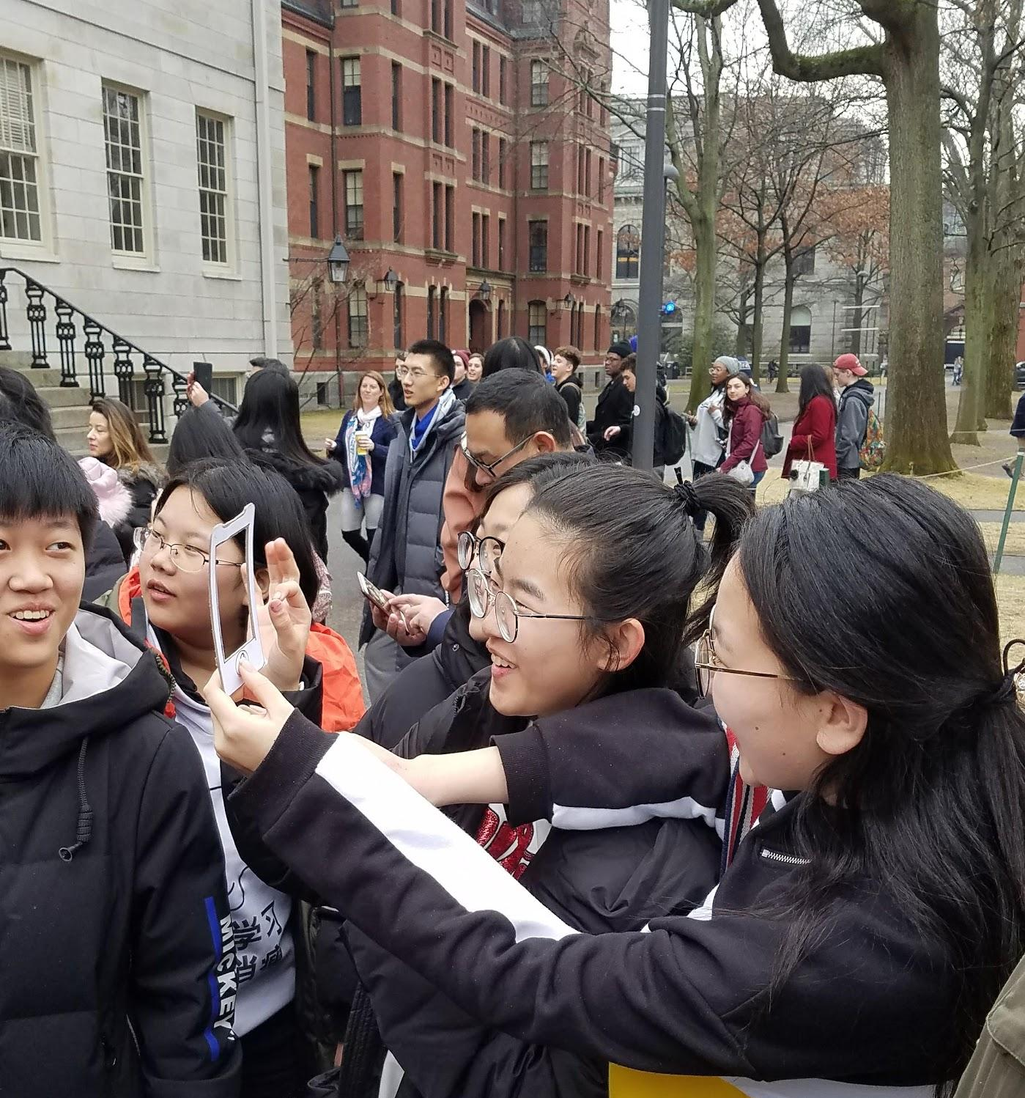
Notes:
- “new, convenient, useful app for students like us...”

Slide 24
Next Steps

Slide 25
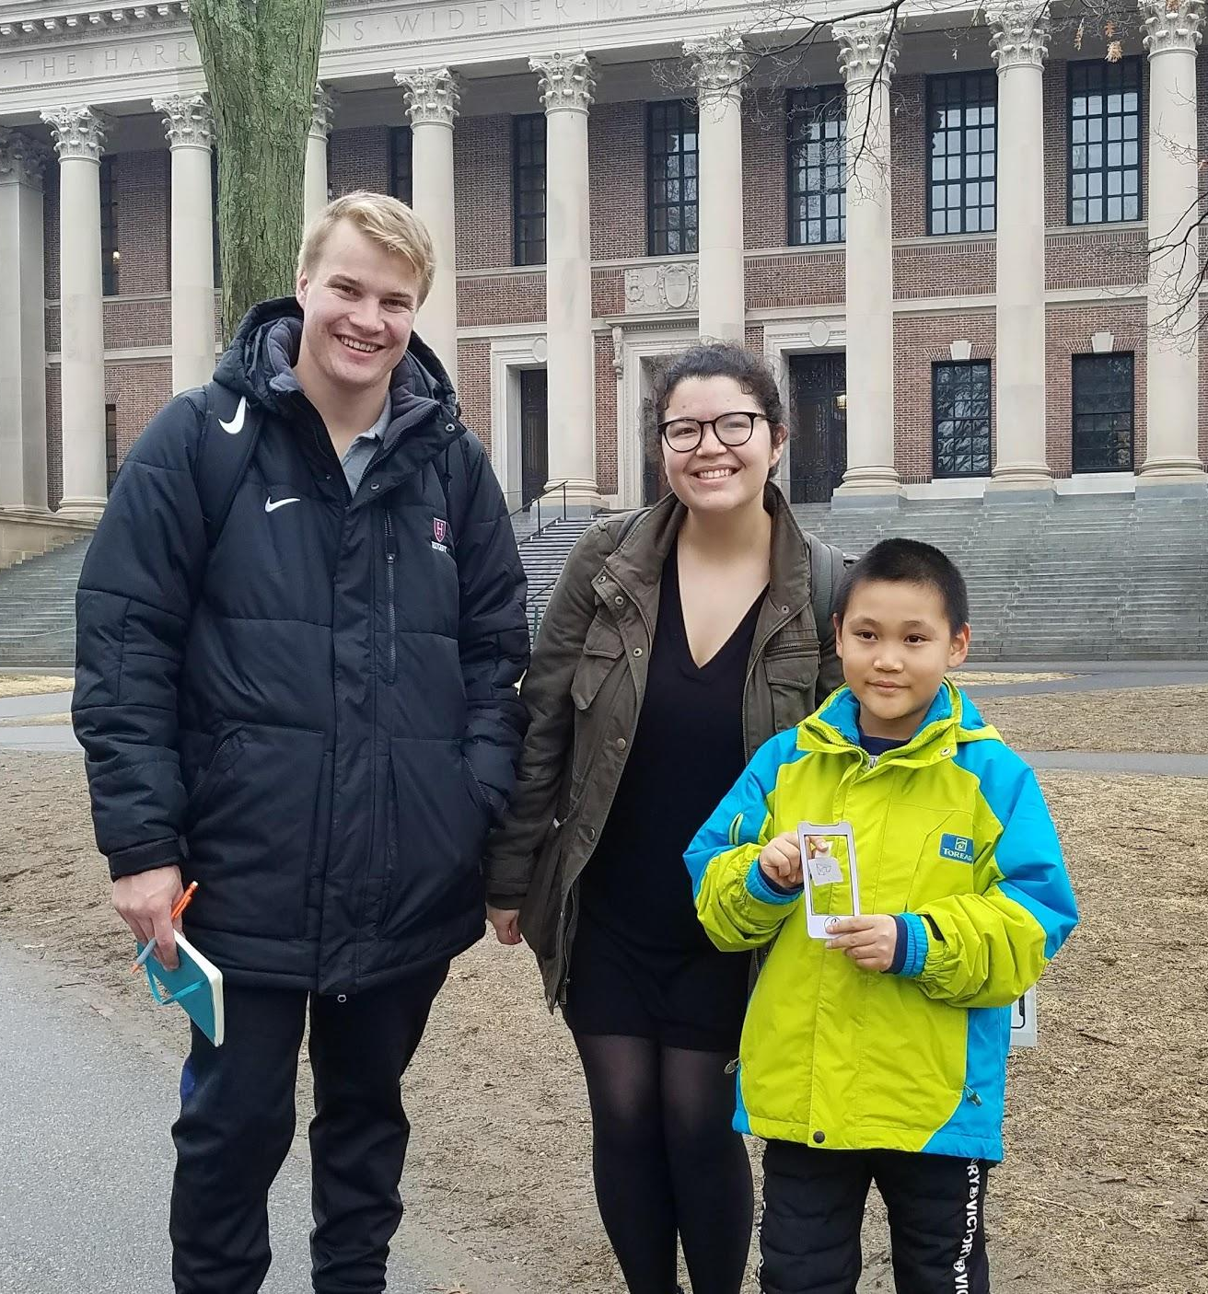
“... optional stories while walking would be more interesting!”
Group of Asian middle school students, in love with Alice
“What happens after getting the treasures?”
Youngest tourist, fascinated by his new game
Notes:
Multiple language-support
Optional stories along the way
Connect finding the jewels to a bigger goal
Secret areas
Videos of interiors
Videos of professors
Deal with the COOP

Slide 26
Questions?

